Slide 1
Case Study 3: Telecom Service Provisioning
Srujana Reddy
Tarun Gupta
Vishweshwari K
Prateek N
Shivanagouda S A

Slide 2
Agenda
1.
Introduction
2.
Tech Stack
3.
Demo
4.
Challenges

Slide 3


Project Overview
Telecom Service provisioning:
The Telecom Service Provisioning system is designed to automate the process of managing telecom services which includes TV Services and Internet Services, including activation, modification, and termination. By automating service provisioning tasks, the system ensures that customers can quickly and easily start, modify, or stop their telecom services, with all changes accurately reflected in the backend MySQL database.

Slide 4
Project Overview
Key features:
1. Service Activation
Activating services for new customers.
2. Service Modification
Allows existing customers to upgrade or downgrade services.
3. Service Termination
Handling service termination requests of users.

Slide 5
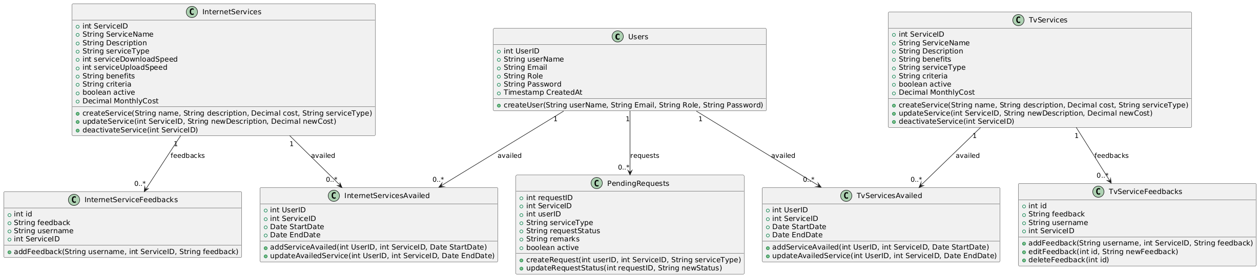
Architecture Diagram
Class diagram:

Slide 6
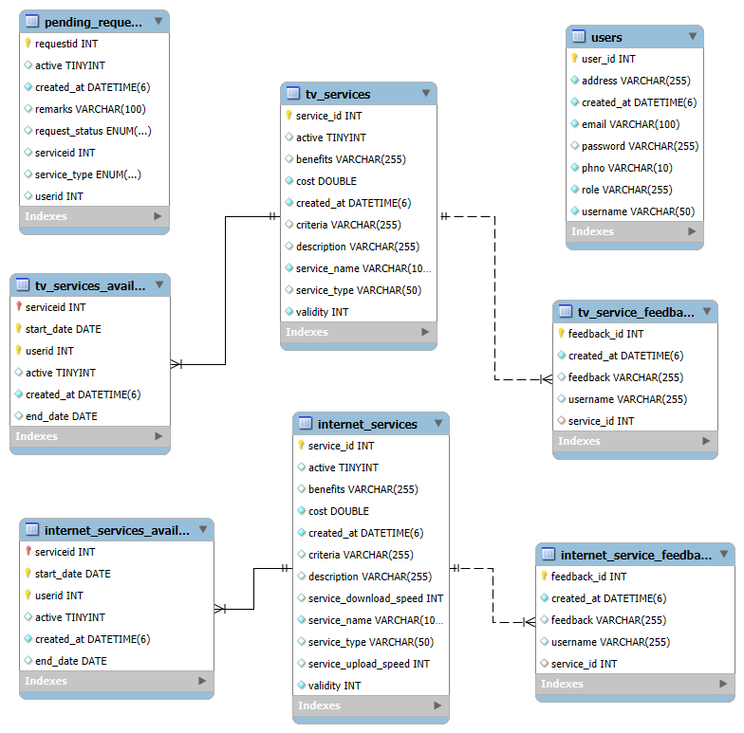
Architecture Diagram
ER diagram:

Slide 7
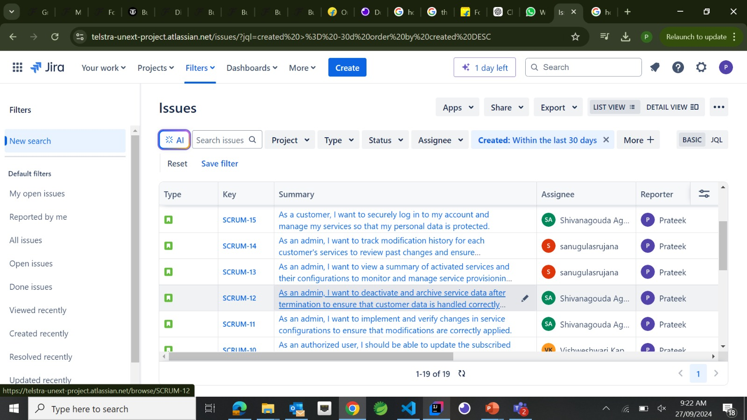
Organizing tasks
Jira:

Slide 8


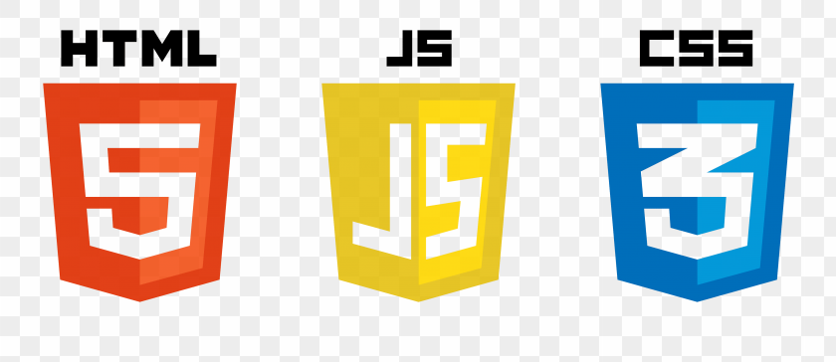
Frontend Overview
Technologies used:
1. React.js
2. JavaScript
Core language for client-side scripting.
3. HTML and CSS3
Structure and styling of web pages.
4. Axios
For making HTTP requests to the backend.
For building dynamic and responsive user interfaces.

Slide 9


Backend Overview
Technologies used:
MySQL
Database for storing and managing customer and service data.
Hibernate/JPA
ORM framework for seamless interaction between the Java application and the MySQL database.
Spring Security
For authentication and securing the API
Spring Boot
Framework for building the backend application, providing robust and scalable solutions for service management.

Slide 10
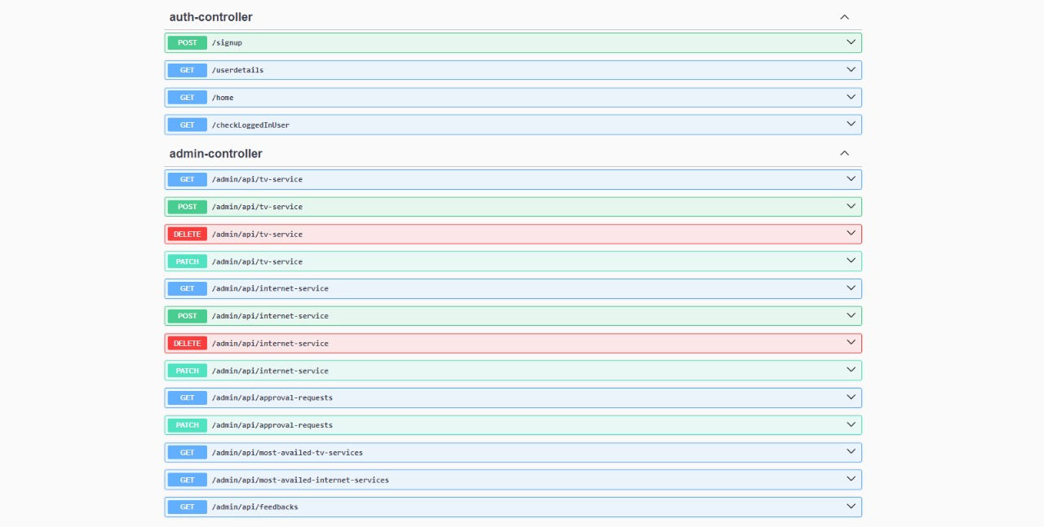
API Endpoints

Slide 11


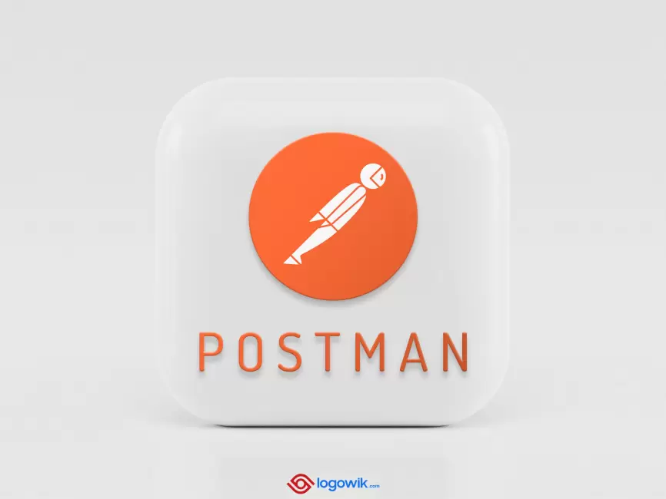

Testing
Technologies Used:
Authentication Validation
Endpoint Exploration
CRUD Operations Testing
Unit Testing

Slide 12
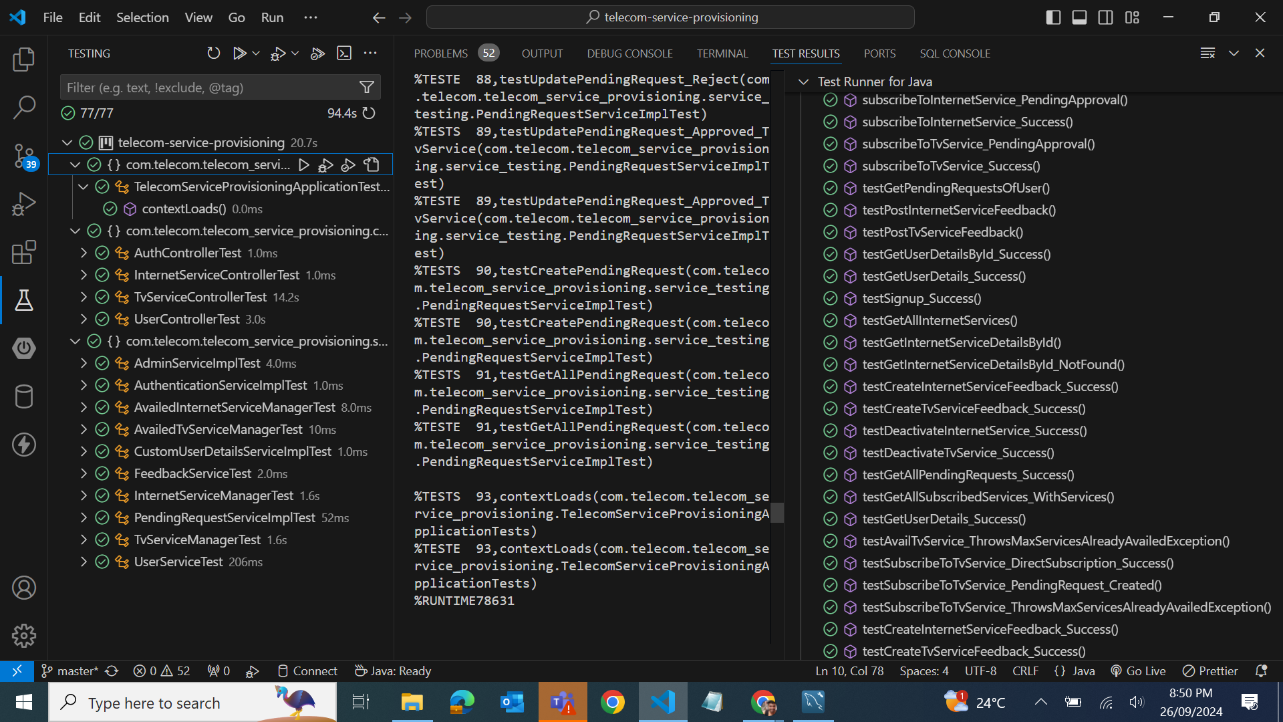
Testcases and Results - Backend

Slide 13
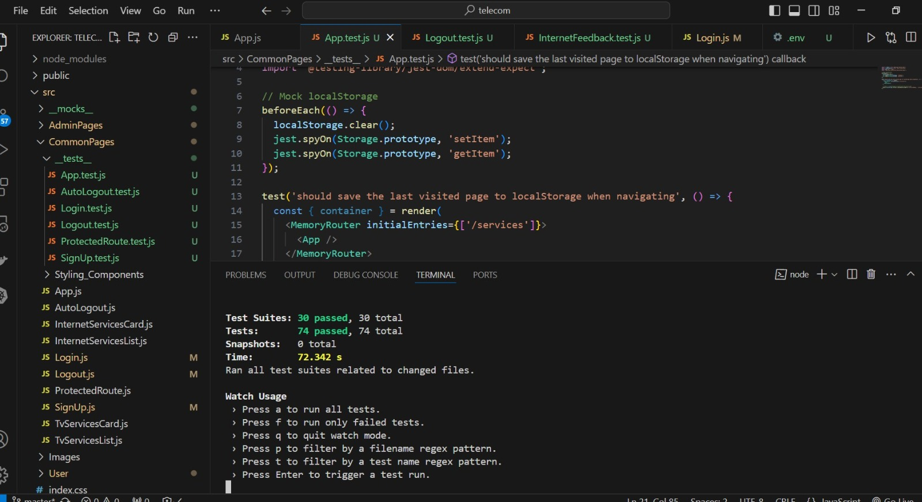
Testcases and Results - Frontend

Slide 14




DevOps Overview
Technologies used:
1. Github
2. Jenkins
An open-source automation server that helps with continuous integration (CI) and continuous delivery (CD).
3. Docker
A platform that automates the deployment of applications inside lightweight, portable containers.
4. AWS
A cloud platform that provides on-demand infrastructure and services such as computing power, storage, and databases
A cloud-based platform for version control, allowing developers to manage and share code repositories using Git.

Slide 15
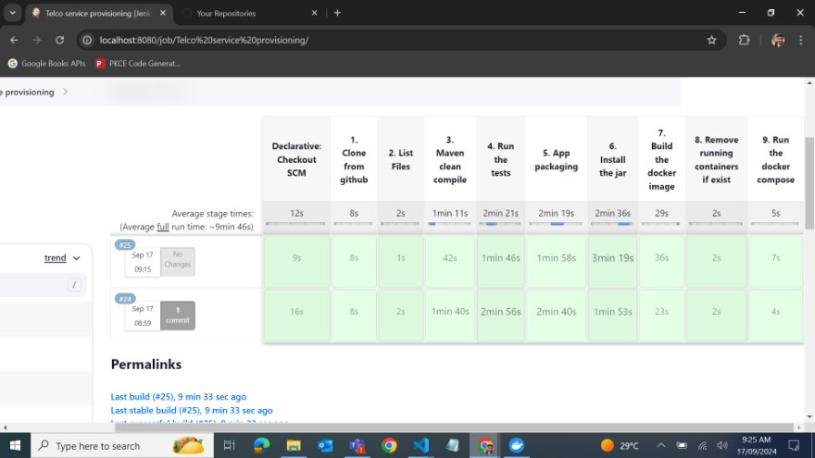
Jenkins Pipeline In Action​

Slide 16
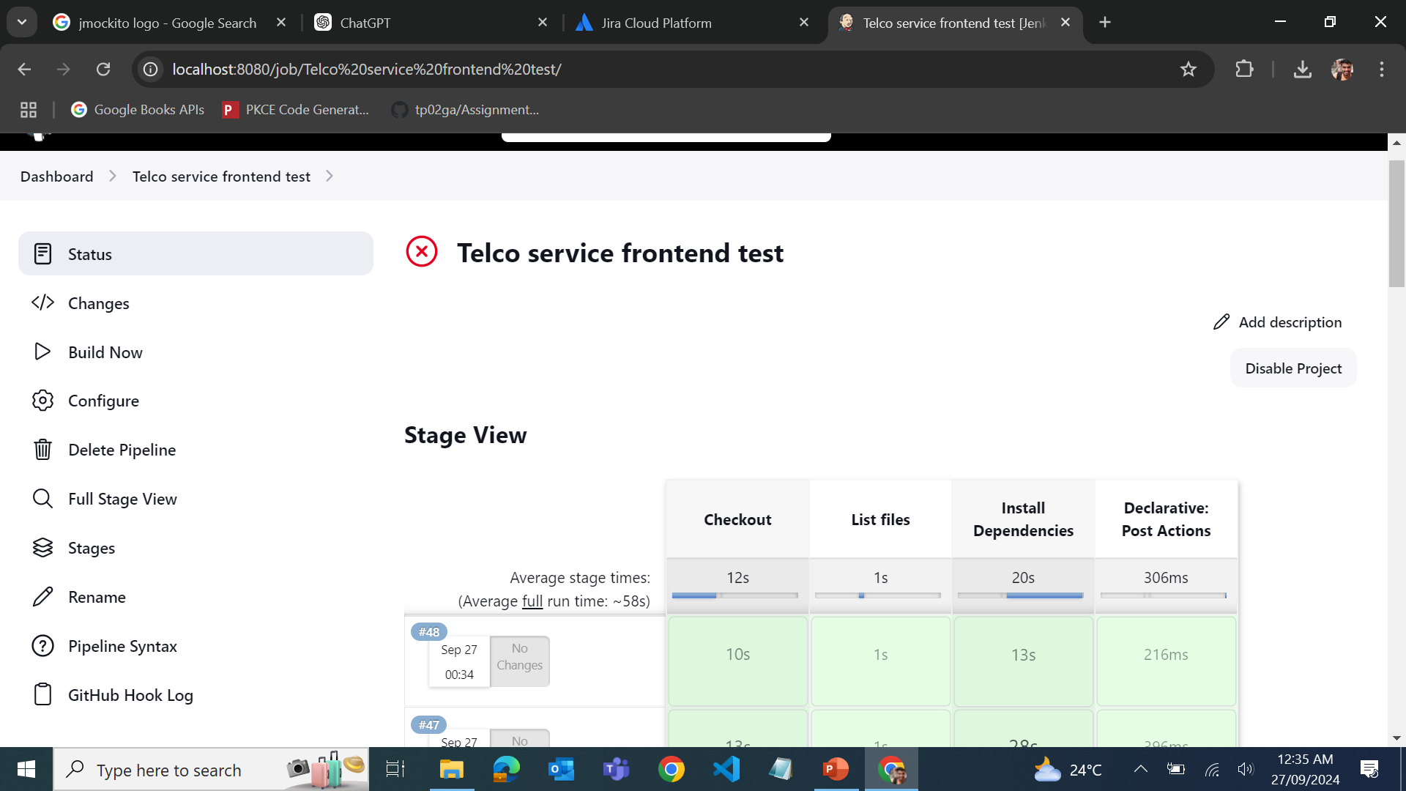
Jenkins Pipeline In Action​

Slide 17
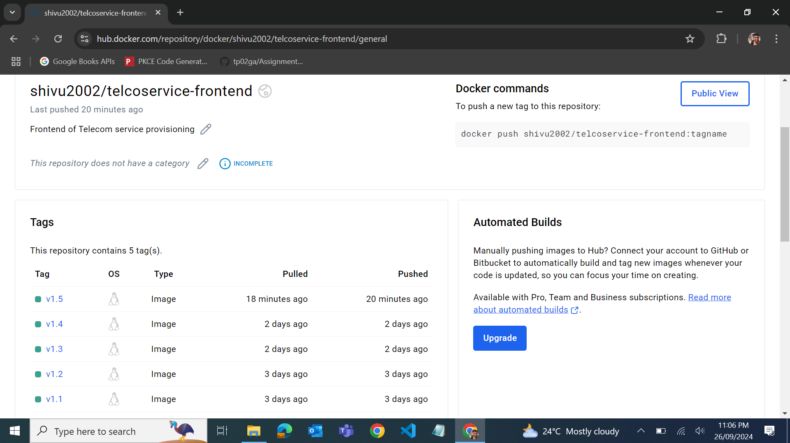
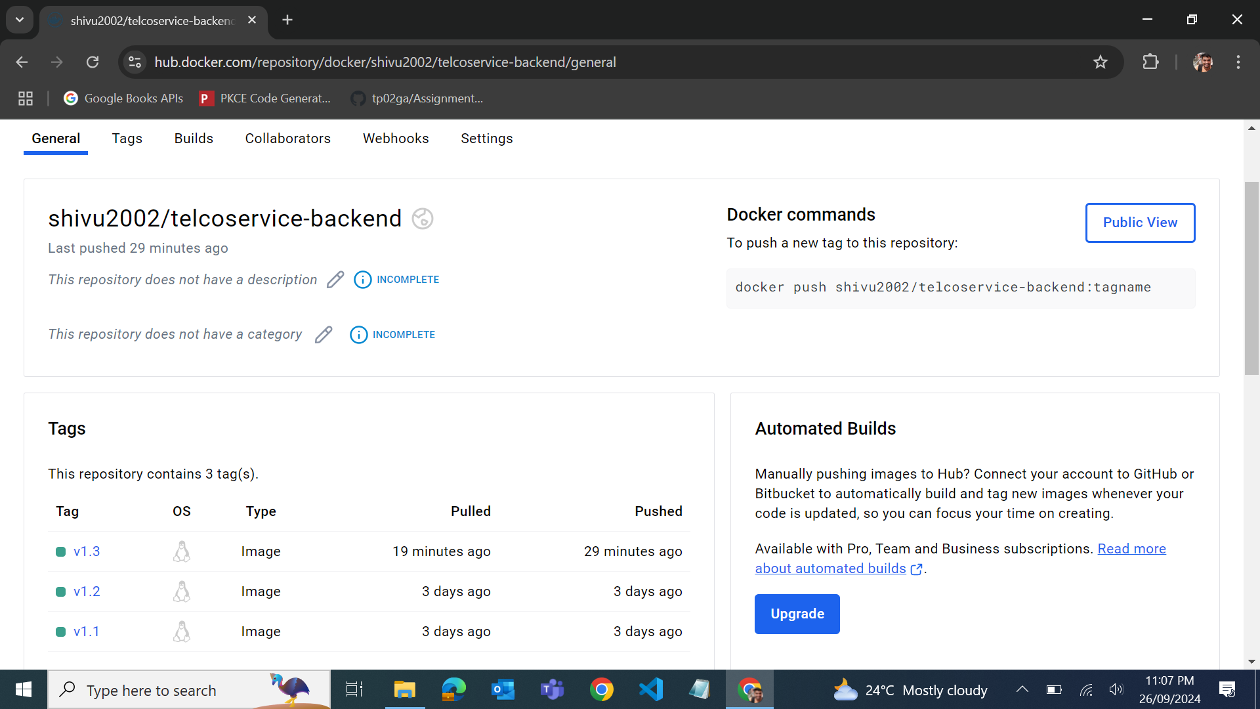
Docker images in Dockerhub

Slide 18
Live Demo

Slide 19
Challenges Faced:
Security
Incompatible Dependencies in spring boot
Jenkins Automation
Docker
Email Service

Slide 20
Future Enhancements
1.Enhanced Security Features such as OAuth2
2. Implementing Microservice architecture
3. Implementation of circuit breakers and load balancer.

Slide 21
Conclusion
In conclusion, the telecom service provisioning project effectively addresses the needs of users and administrators by providing a streamlined platform for managing internet and TV services.
The well-structured database schema ensures efficient data handling and seamless interactions between key entities, such as users, services, and pending requests. This project not only demonstrates a solid understanding of backend and frontend technologies but also lays a strong foundation for continued innovation and improvement in telecom service management.

Slide 22
Any Questions?

Slide 23
Backend Code: https://github.com/shivu2002a/telecom-service-provisioning
Frontend Code:
https://github.com/SanugulaSrujana/Telcoservice-frontend

Slide 24
Thank You

